Slide 1
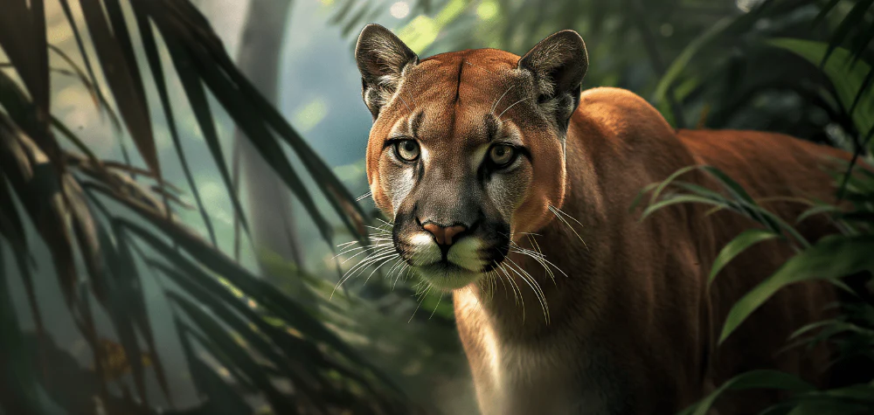
Puma – The Mountain

Slide 2
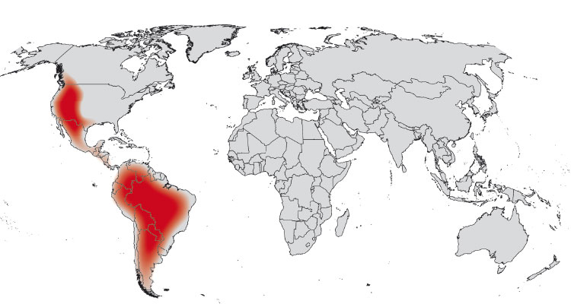
Introduction:
Pumas are big wild cats.
They live in the south America.
They are very fast and strong.

Slide 3
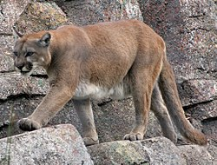
Appearance:
Light brown fur.
Long tail.
Can weight up to 100 kg.
About 2 meters long including tail.

Slide 4
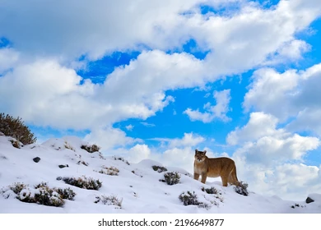
Habitat:
Live in forests, mountains, deserts and grasslands.
Found from Canada to South America.
Need large areas to hunt.

Slide 5
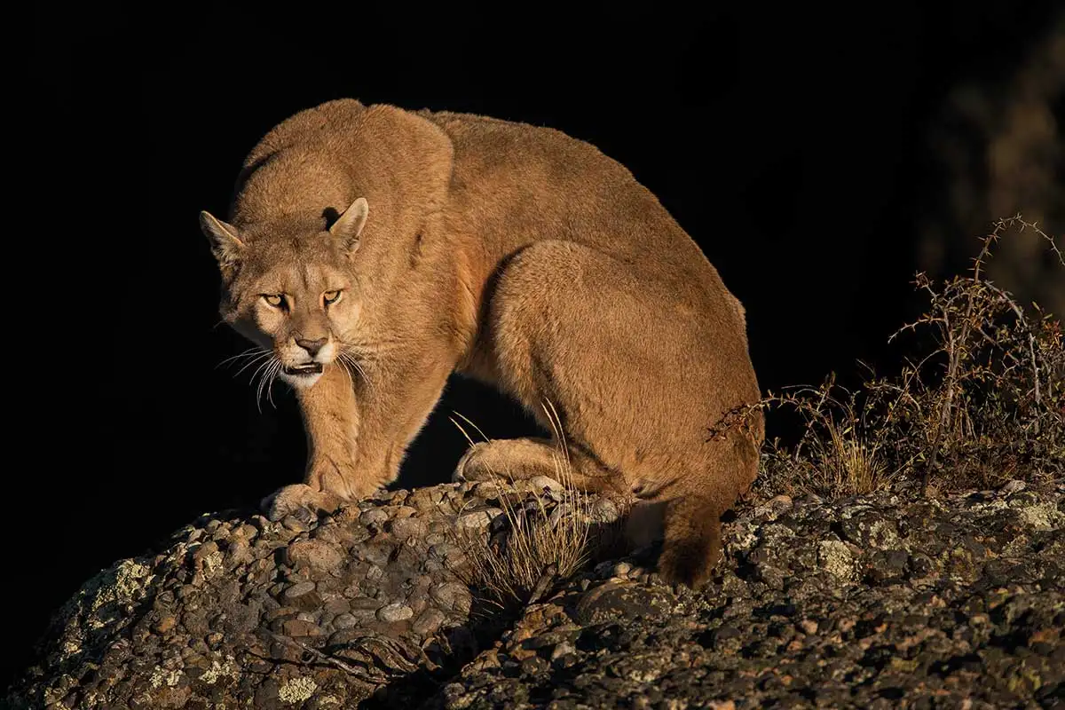
Diet:
They are carnivores – eat meat.
Eat deer, rabbits, birds, and sometimes livestock.
Hunt mostly at night.

Slide 6
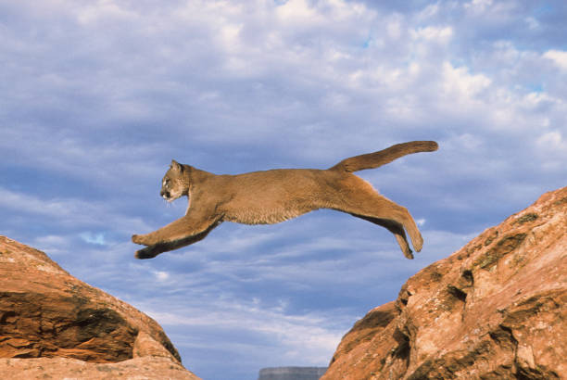
Behavior:
Usually live alone.
Very quiet and sneaky hunters.
Can jump up to 5 meters in the air.

Slide 7
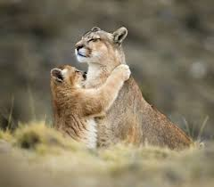
Babies:
Called cubs.
Usually 2-4 cubs in a litter.
Stay with mother fot about 1-2 years.

Slide 8
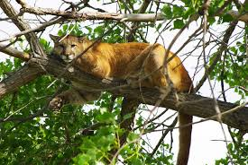
Threats:
Humans are the biggest threat.
Habitat loss and hunting.
Sometimes killed to protect livestock.

Slide 9
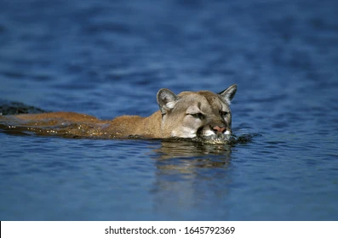
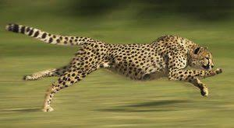
Fun Facts:
Pumas can run up to 80km/h
Can climb trees and swim well.
Pumas are very important for nature they keep animal populations balanced.

Slide 10
Thank you for your attention.
ALEX BOCEK 6.D

